Slide 1
DAY 1

Slide 2
AGENDA
Course Introduction
Learning outcomes
Assignments and expectations
Intro to Big Data Management Fabric
Hadoop
Spark

Slide 3
COURSE INTRO:
Day 1 : Key concepts
Day 2: Hadoop
    Hadoop Distributed File System (HDFS)
    MapReduce
    HDFS commands
Day 3: YARN
Day 4: Spark

Slide 4
Day 5: Apache Spark
  Resilient Distributed Dataset (RDD)
Day 6: Spark SQL
Day 7: Spark MLlib
Day 8: Spark Streaming Demo + Final Project Presentation

Slide 5
LEARNING OUTCOME:
To gain understanding of the characteristic of big data.
To know techniques for working on big data platforms.
To have some experiences of performing the techniques.

Slide 6
ASSIGNMENTS:
GRADING
ALL assignments are due Nov 31, 2024, 11:59 PM, PST. (Note: Any late submission after the due day could lead to a 10% deduction on each late submission.)

Slide 7
ATTENDANCE:
I update the attendance sheet periodically. Email me at kkowarsc@uci.edu AND the department for sick absences or urgent events.

Slide 8
BIG DATA

Slide 9
HOW LARGE CAN OUR DATASET BE?
Enron SPAM Data (100k articles)
Google ngram corpus (2.2 GB)
Chat GPT-2 corpus (40GB)
Wikipedia graph (2 GB)
$100 Billion problem (Click-through rate or CTR) prediction (20-30 GB)
Airlines and Weather - predicting delays (20-40GB)
Llama 3 pre-trained ( on15 TB tokens)

Slide 10
HOW LARGE CAN OUR DATA BE?
When it is O(n): about 33 minutes
Assumption:
Your personal laptop has the following features”
Storage: 1TB
RAM: 16GB
Inteli7
Your task is working on a dataset of 20GB
Complexity | Runtime
O(n) | 33 mins
O(nlogn) | 46 mins
O(n^2) | 111 days
O(2^n) | 340 years

Slide 11
HOW LARGE CAN OUR DATA BE?
def bubble_sort(arr):
n = len(arr)
for i in range(n):
# Last i elements are already in place
for j in range(0, n-i-1):
# Swap if the element found is greater than the #next element
if arr[j] > arr[j+1]:
arr[j], arr[j+1] = arr[j+1], arr[j]
arr = [64, 34, 25, 12, 22, 11, 90]
bubble_sort(arr)
print("Sorted array:", arr)
Time complexity: O(n^2)
Inefficient algorithms are usually Naïve Modeling with nested loops.

Slide 12
HOW LARGE CAN OUR DATA BE?
def generate_subsets(s):
if len(s) == 0:
return [[]]
subsets_without_first = generate_subsets(s[1:])
subsets_with_first = [[s[0]] + subset for subset in subsets_without_first]
return subsets_without_first + subsets_with_first
my_set = [1, 2, 3]
subsets = generate_subsets(my_set)
print(subsets)
An algorithm with an exponential runtime complexity of O(2^n) is generating all subset of a set.
Recursive algorithm

Slide 13
HOW LARGE CAN OUR DATA BE?
def fibonacci(n):
if n <= 1:
return n
else:
return fibonacci(n-1) + fibonacci(n-2)
result = fibonacci(5)
print(result)
Time complexity: O(2^n)
Fibonacci sequence using naïve modeling approach.
Recursive algorithm

Slide 14
HOW LARGE CAN OUR DATA BE?
Fibonacci Sequence
def fibonacci_generator(n):
a, b = 0, 1
count = 0
while count < n:
yield a
a, b = b, a + b
count += 1
# Using the Fibonacci generator
fib_gen = fibonacci_generator(5)
for num in fib_gen:
print(num)
Time complexity: O(n)

Slide 15
HOW TO DEAL WITH BIG DATA?
Recall the traveling salesman problem: find out the shortest route that visits each city exactly once and returns to the original city. The naive brute-force approach is O(n!) or O(2^n)

Slide 16
PARALLELISM
Divide and Conquer

Slide 17
Mergesort
The divide-and-conquer nature of the algorithm makes merge sort a perfect fit for an embarrassingly parallel framework. The worst-case time complexity of merge sort is O(n log n).

Slide 18
HOW TO DEAL WITH BIG DATA?
Merge sort algorithm
Google Colab

Slide 19
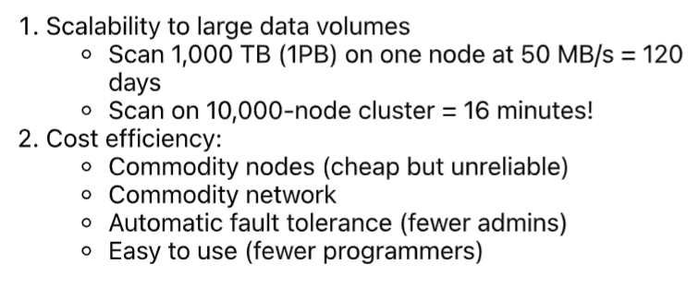
DIVIDE AND CONQUER
Goal

Slide 20
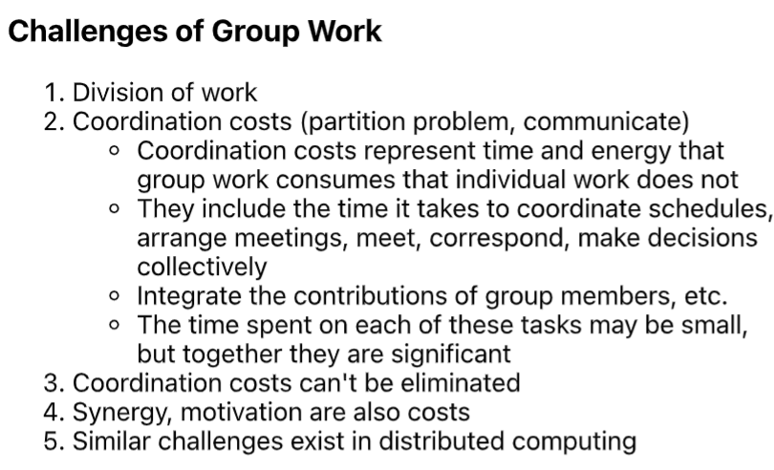

Slide 21
PARALLEL COMPUTING
Breaking the problem into independent components so that each processing element can execute its part of the algorithm simultaneously with the others.
The processing elements can be diverse and include resources such as
  a single computer with multiple processors,
  several networked computers, specialized hardware, or
  a combination of the above.
A type of synchronization through devices

Slide 22
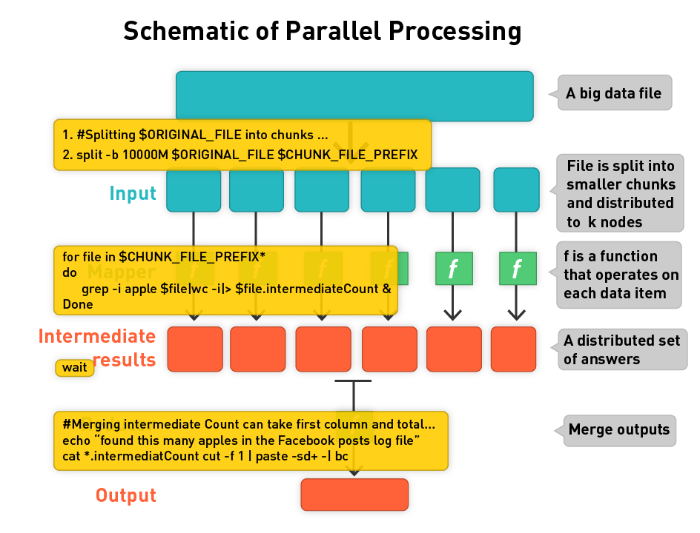

Slide 23
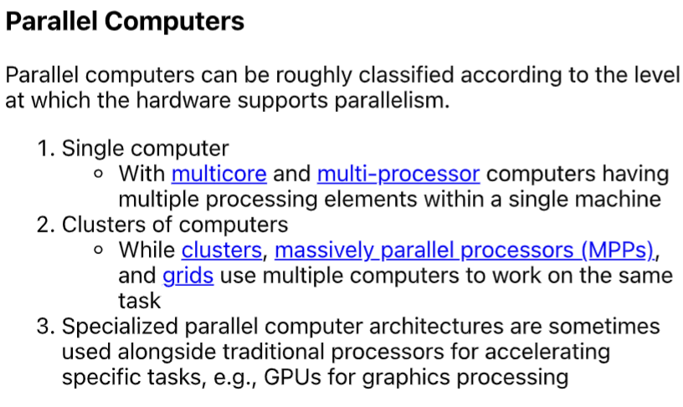
PARALLEL COMPUTERS

Slide 24
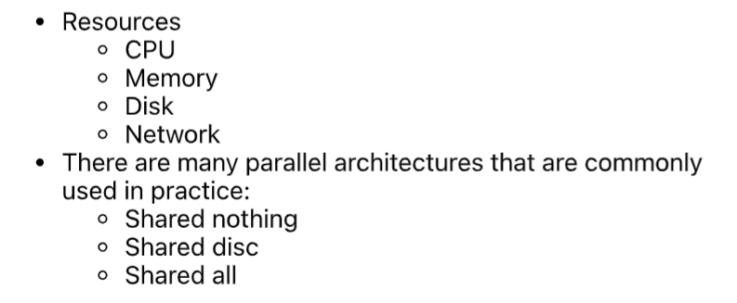
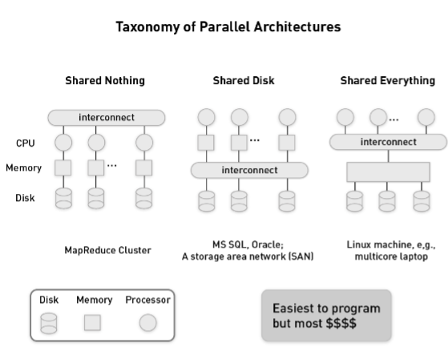
PARALLEL SYSTEMS
Resources, like memory and I/O devices, are accessible by all processors.

Slide 25
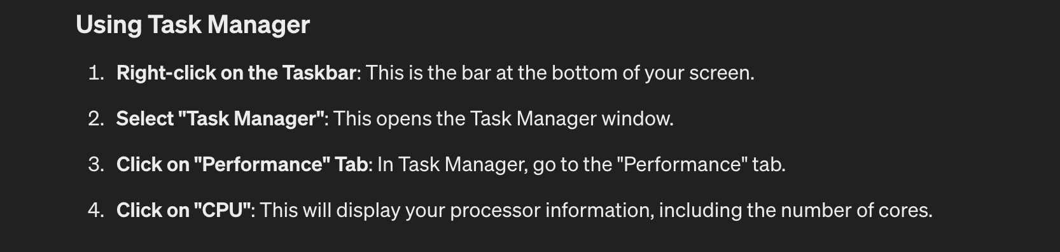
PARALLEL COMPUTERS
Windows users
Hardware Overview:
Model Name: MacBook Pro
Model Identifier: MacBookPro15,1
Processor Name: 6-Core Intel Core i7
Processor Speed: 2.6 GHz
Number of Processors: 1
Total Number of Cores: 6
L2 Cache (per Core): 256 KB
L3 Cache: 9 MB
Hyper-Threading Technology: Enabled
Memory: 16 GB
System Firmware Version: 2022.100.22.0.0 (iBridge: 21.16.4222.0.0,0)
OS Loader Version: 580~1678
Serial Number (system): C02YG2XXXX
Hardware UUID: 418D713A-2808-54D3-B7A2-8B6F0C7D8251
Provisioning UDID: 418D713A-2808-54D3-B7A2-8B6F0C7D8251
Activation Lock Status: Enabled

Slide 26
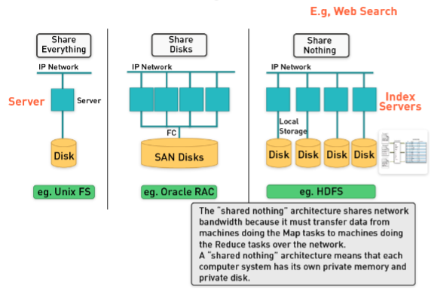
SHARE ARCHITECTURE

Slide 27


DATA LOCALITY AND ISOLATION
Moving data to computation nodes is hard
Network bandwidth is limited

Slide 28
FRAMEWORK FOR PARALLEL COMPUTATION
Cluster and grid computing
  Provide logical abstractions
  Libraries implementing the message passing interface (MPI) for same local network
  MapReduce is a framework processing parallelizable problems across huge data sets, using large number of pcs or nodes, cluster or grid (nodes are shared across geographically or heterogeneous hardware)

Slide 29
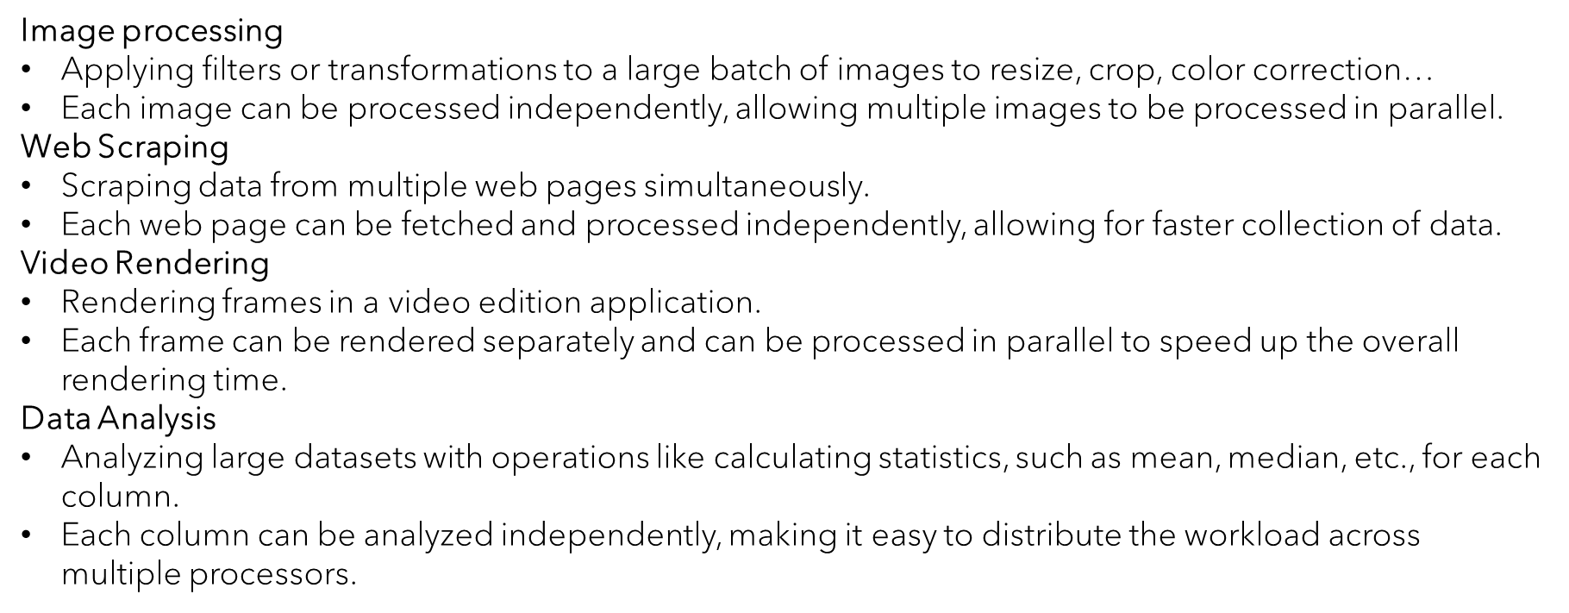
Embarrassingly Parallel Situation

Slide 30
MAP AND REDUCE
Map phase dominates, the complexity is O(n*m), where n:input size; m: number of mappers (like log file analysis)
If the reducer phase dominates, the overall complexity is O(n*r*m), where r is number of reduce tasks (example?)
What if the number of tasks are processed by many computers?

Slide 31
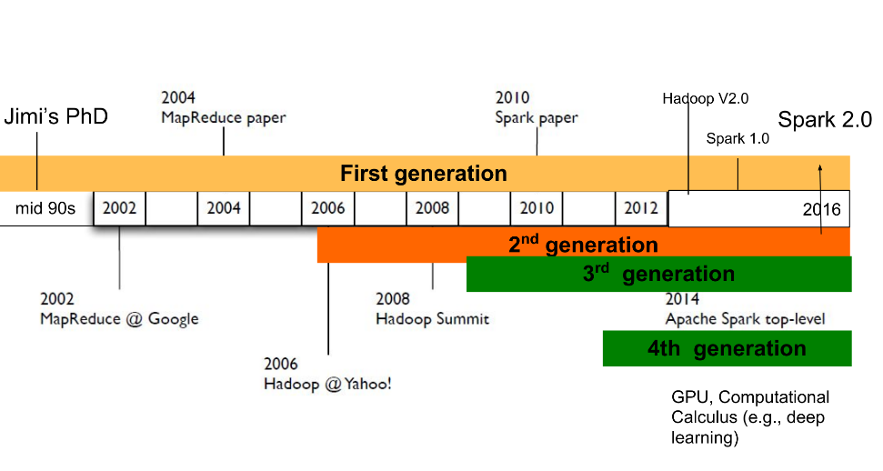
EVOLUTION OF MAPREDUCE FRAMEWORK

Slide 32
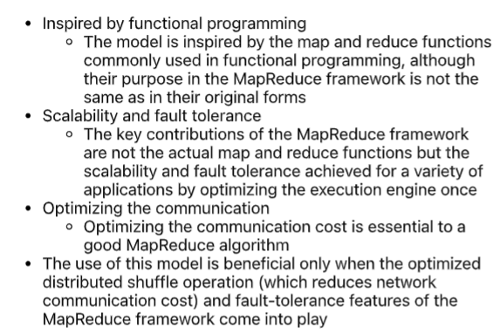
MAPREDUCE + SCALABILITY + FAULT TOLERANCE

Slide 33
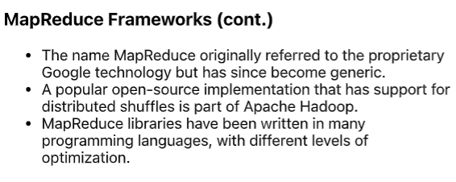

Slide 34
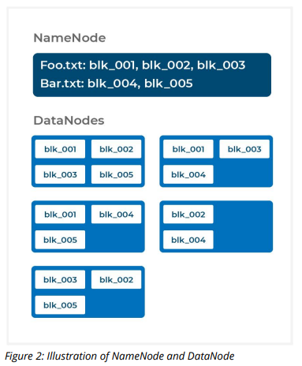

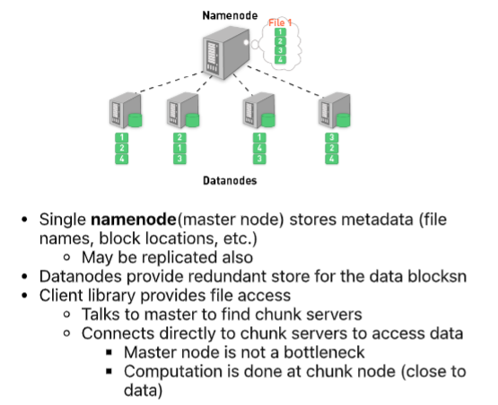

Hadoop Distributed File System

Slide 35
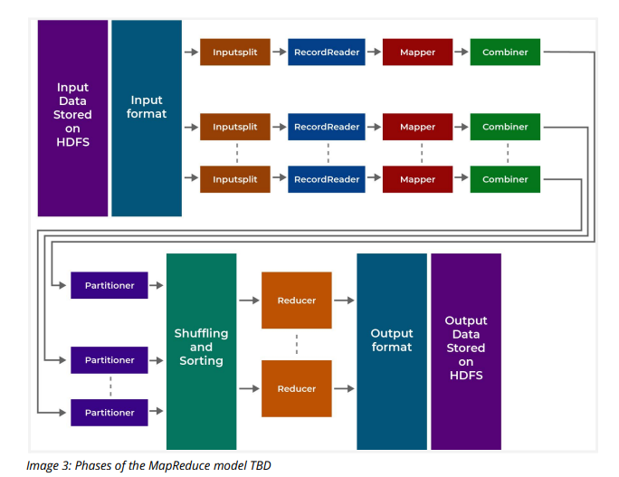
Hadoop Distributed File System

Slide 36
SPARK

Slide 37
SPARK
An open-source, distributed computing framework designed for speed and ease of use.
In-memory processing capabilities, allowing it to perform computations much faster than traditional batch processing systems like Hadoop MapReduce.
Supports various programming languages (Scala, Java, Python, R) and offers high-level APIs like Spark SQL, Spark Streaming, MLlib (machine learning), and GraphX (graph processing).
Resilient Distributed Datasets (RDDs) as the primary data abstraction, which are distributed, immutable, and fault-tolerant data structures.
Offers interactive querying, real-time processing, iterative algorithms, and complex analytics workloads.

Slide 38
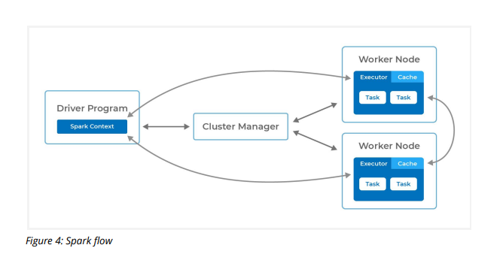
SPARK
An executor can do many tasks
Driver: orchestrates the job flow, schedule tasks, and is in working mode when the application is running
A Spark application maps to a single driver process and series executors.

Slide 39
DIFFERENCES
 | Hadoop | Spark
Processing Model | Disk-based storage | In-memory processing
Data Abstraction | Stored in HDFS and using MapReduce | RDD
Use | Write MR jobs in Java | Higher-level APIs (Shell, PySpark) and libraries
Real-time Processing | Batch processing | Streaming

Slide 40
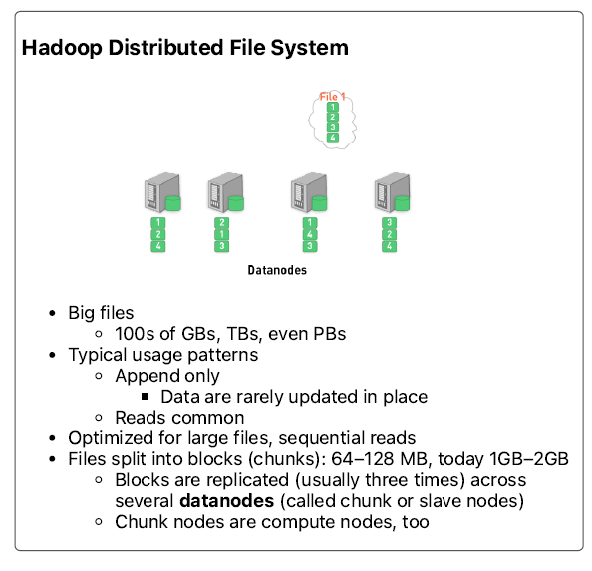
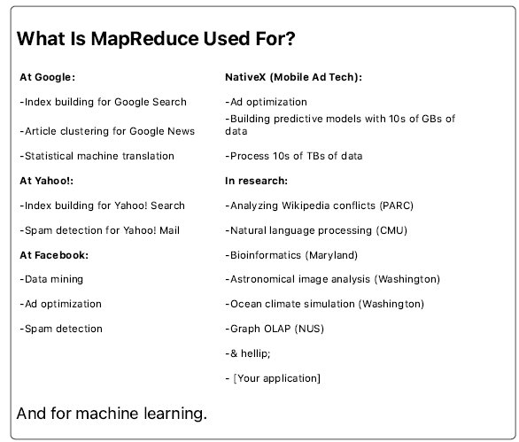

Slide 41
BUSINESS CASE
Big Data Analytics in Marketing
  Businesses use Hadoop or Spark for tasks such as customer segmentation, market basket analysis, sentiment analysis, and predictive modeling.
Data Warehousing
  Big data technique serves as a cost-effective solution for storing and processing vast amounts of data in a distributed manner.
  Integrate and analyze diverse data sources, build data lakes.

Slide 42
BUSINESS CASE
Log File Processing and Analysis
  Processing and analyzing log data generated by applications, servers, and network devices in memory.
Recommendation Systems
Fraud Detection and Risk Management
Internet of Things or IoT Data Processing
  Massive volumes of real-time data from IoT devices

Slide 43
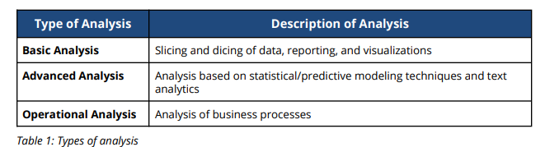
ANALYTICS AND BIG DATA

Slide 44
WHAT DID YOU LEARN?
Quiz
Discussion

Slide 45
DAY 2 INTRO TO HADOOP
Data structure and system review

Slide 46
DAY 2 INTRO TO HADOOP
Hadoop Cluster
Building blocks of Hadoop
  Using Hadoop distributed file system
  What is MapReduce?
    Basics of a MR Flow

Slide 47
HADOOP
  Hadoop is an open-source distributed computing framework that allows for the distributed storage and processing of large datasets across clusters of computers.
  It consists of two main components: Hadoop Distributed File System (HDFS) for distributed storage and MapReduce for distributed processing.
    Single namespace for entire cluster
    Replicates data 3X for fault tolerance
  Hadoop MapReduce (Google:20 PB /day or 21 million GB)
    a programming model for execute the map and reduce functions
    manages works distribution and fault tolerance

Slide 48
HADOOP
  Hadoop common utilities
  Avro, a data serialization system with scripting languages
  HDFS
  Hive for ad hoc query
  MapReduce, distributed processing on computer

Slide 49
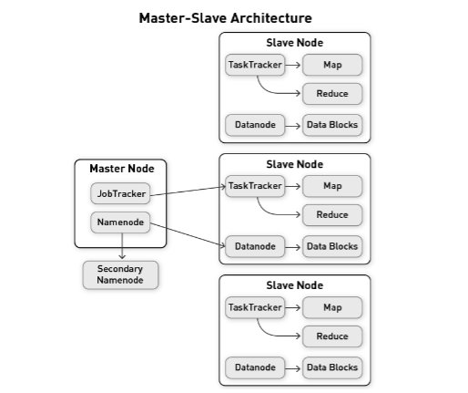
HADOOP
Scalable,
Robust
Accessible
Efficient?
Mapper:
key-value 🡪 key’-value’
Reducer: aggregation
Partitioner:
the reducer receives all
values of the same keys
Tasktracker:
monitor all tasks,
assigns nodes to the different tasks,
determines which files need to be processed

Slide 50
HADOOP

Slide 51
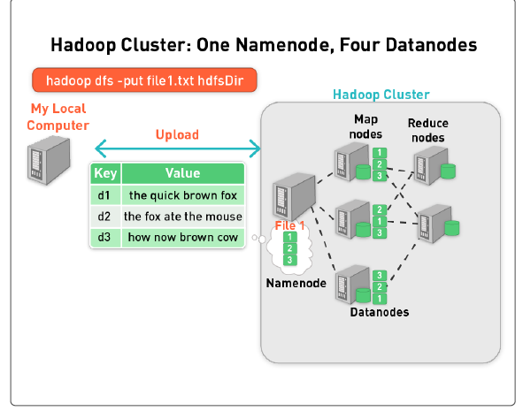
HADOOP CLUSTER
assume block size is 20 characters

Slide 52
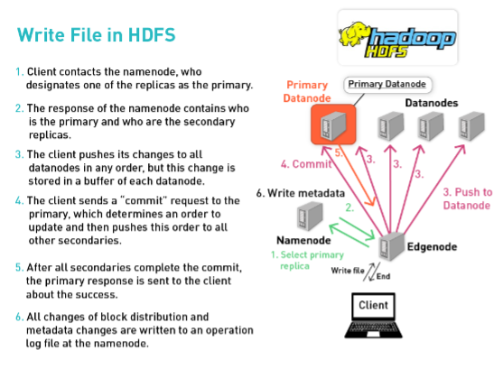

Slide 53
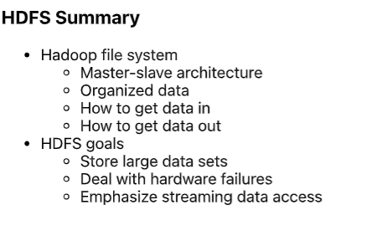

Slide 54
BUILDING BLOCKS OF HADOOP
Hadoop Distributed File System: data repo that stores all data which is processed by the Hadoop application
MapReduce: processing program to deal with the data in HDFS
HDFS and MapReduce provide a framework that supports for distributed storage and distributed computation within a Hadoop cluster.
100 TB data file
Block 1
Block 3
Block 5
Block 4
Block 2
Block 6
Hadoop data distribution

Slide 55
MAPREDUCE

Slide 56
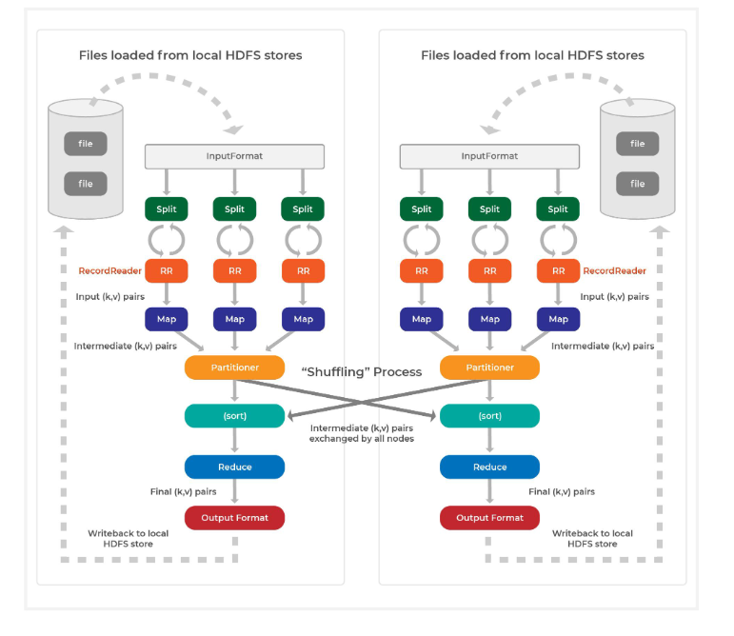
MapReduce Framework

Slide 57
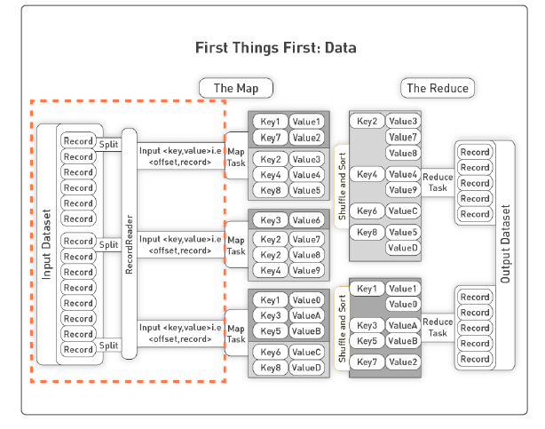

Slide 58
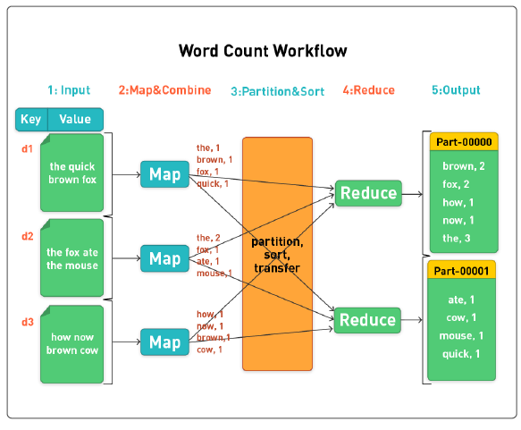

Slide 59
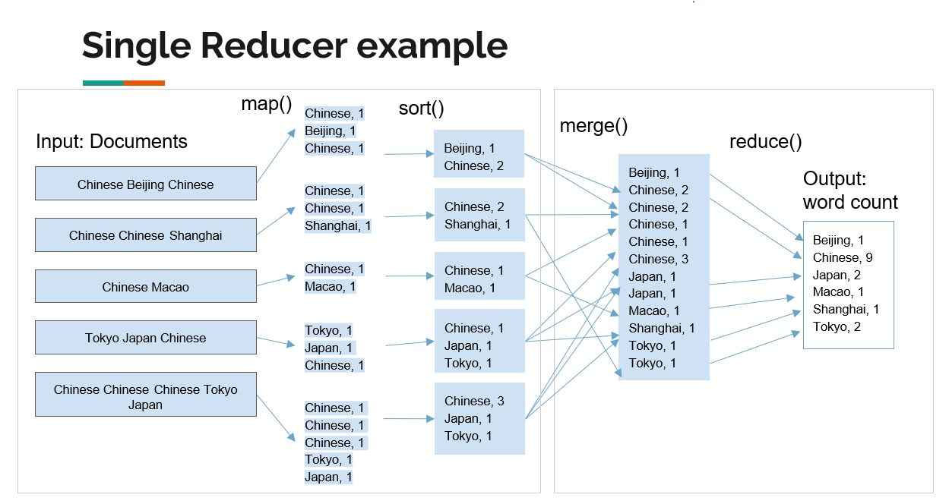

Slide 60
MAPREDUCE - KEY CONCEPTS
Phases of MapReduce
Map phase
  Each mapper takes a line as input and breaks it into words. It then emits a key/value pair of the word and 1.
Shuffle/sort phase (partition and sort the mapper output)
  The output from the mappers is sorted by key and shuffled into the reducers such that key/value pairs with the same key end up in the same reducer.
  Sort is a simple and very useful command found in Unix systems. It rearranges lines of text numerically and/or alphabetically. (Hadoop Streaming KeyBasedComparator is modeled after Unix sort, and utilizes command line options which are the same as Unix sort command line options).
  http://www.theunixschool.com/2012/08/linux-sort-command-examples.html
Reduce phase
  Each reducer sums the counts for each word and emits a single key/value with the word and sum.

Slide 61
HADOOD INSTALLATION IN COLAB

Slide 62
1. COPY DATA TO HDFS
! {hadoop_path} fs -put -f $local_txt_file $hdfs_txt_file

Slide 63
2. MAP FUNCTION
Splitting lines to words
df.withColumn("words", f.split("value", " "))
Transforming each word into a key-value pair (voc, 1)
df.withColumn("word", f.explode("words"))

Slide 64
3. PARTITION AND SORT

Slide 65
4. SHUFFLE/AGGREGATE /REDUCE
.groupBy("word") or reduceBy()???
.count()
Note that groupBy() typically cause a shuffle in order to aggregate the counts for each unique word

Slide 66
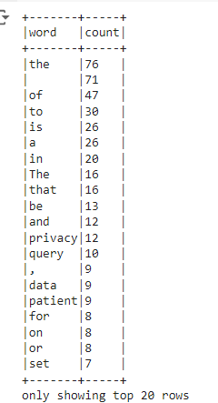
5. OUTPUT
from pyspark.sql import SparkSession
from pyspark.sql import functions as f
# Create a SparkSession
spark = SparkSession.builder.getOrCreate()
# Clear the Spark session
spark.stop()
spark = SparkSession.builder.getOrCreate()
# Read the text file from HDFS
hdfs_txt_file = '/mydata/HW6_Kowarsch.txt'
df = spark.read.text(hdfs_txt_file)
# Perform word count
word_count = (df
.select("value")
.withColumn("words", f.split("value", " "))
.select("words")
.withColumn("word", f.explode("words"))
.groupBy("word")
.count()
.orderBy("count", ascending=False))
# Display the results
word_count.show(n=20, truncate=False)

Slide 67
WHAT DID YOU LEARN ?

Slide 68
DAY 3
Advanced MR Concepts and Hadoop 2.0

Slide 69
Limitations of Hadoop (1)

Slide 70
Hadoop 1 vs. Hadoop 2
YARN: yet another resource negotiator
Hadoop 1 | Hadoop 2
HDFS | HDFS
MR | YARN & MR v2

Slide 71
YARN
Yet Another Resource Negotiator
YARN provides a more generalized and flexible system for managing resources and scheduling jobs within a Hadoop cluster

Slide 72
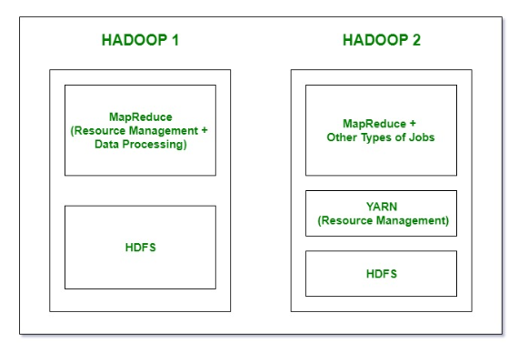
Working:
https://www.geeksforgeeks.org/difference-between-hadoop-1-and-hadoop-2/
Notes:
in hadoop 1, there is HDFS which is used for storage and top of it. Map reduce which works as Resource management and data processing. because of this, it will affect the performance.
in hadoop 2, there is also HDFS which again used for storage and on the top of HDFS, there is YARN which works as resource management. it basically allocated the resource and keeps all the things working.

Slide 73
Hadoop 1: one master and multiple slaves
Hadoop 2: multiple master nodes (namenodes and standby namenodes) and multiple slaves

Slide 74
Daemons:
Hadoop 1 | Hadoop 2
Namenode | Namenode
Datanode | Datanode
Sec Namenode | Sec Namenode
Job Tracker | Resource Manager
Task Tracker | Node Manager

Slide 75
Hadoop 1: No windows
Hadoop 2: yes

Slide 76
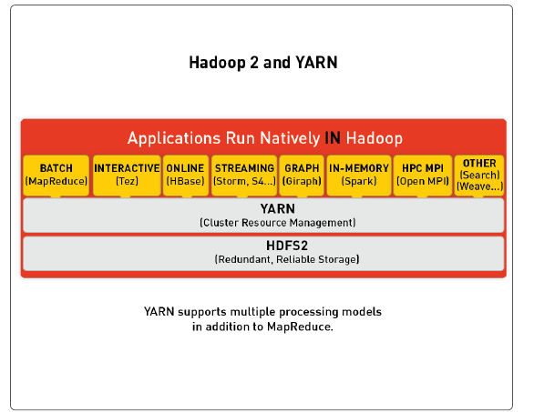

Slide 77
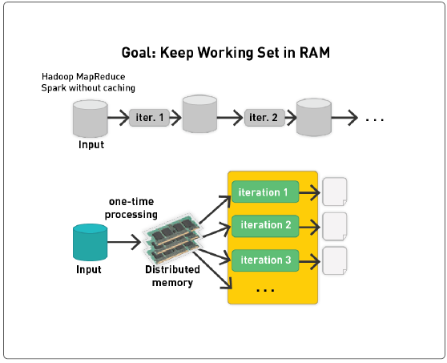

Slide 78
HADOOP AND SPARK
Hadoop | Spark
HDFS: a distributed file system that stores data across multiple machines. | Unified Analytics Engine: for fast computation, batch, real-time, and iterative algorithms
MapReduce: A programming model for processing large datasets with a distributed algorithm on a cluster | In-Memory Processing
Hadoop Ecosystem: Hive (SQL queries), Pig (data flow), Hbase, etc | Ease of Use APIs for Java, Scala, Python, and R

Slide 79
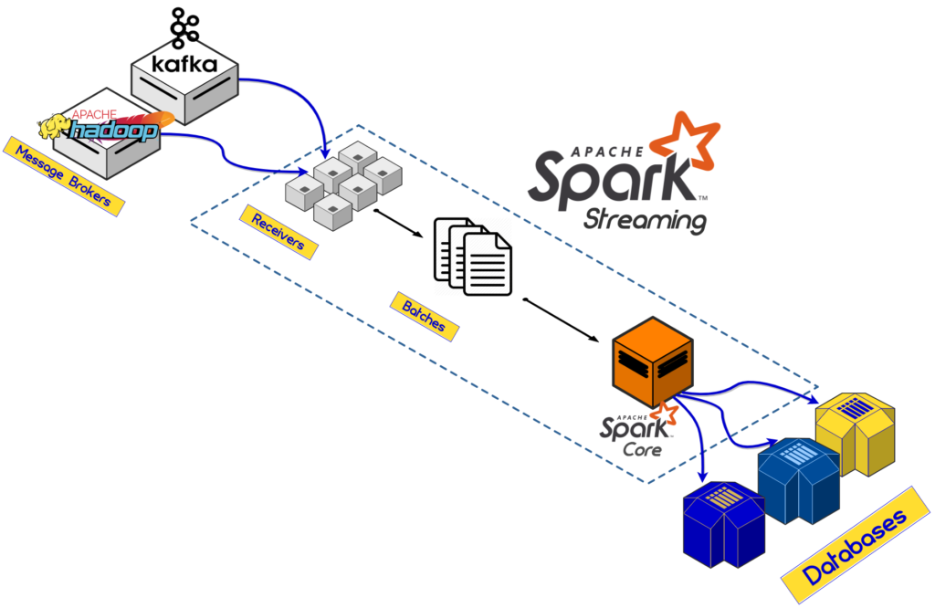
Source:logz.io/blog/Hadoop-vs-spark

Slide 80
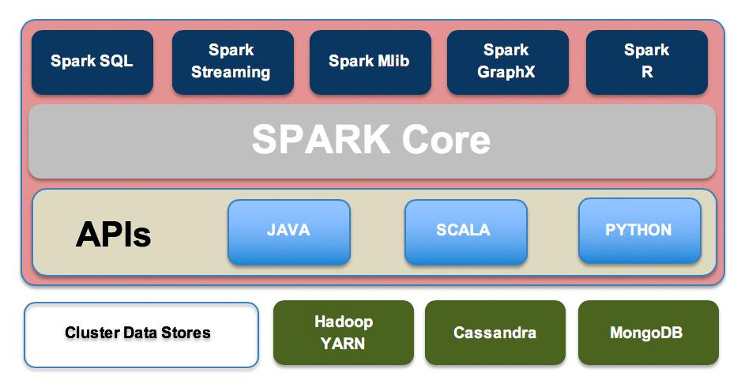
Source:logz.io/blog/Hadoop-vs-spark

Slide 81
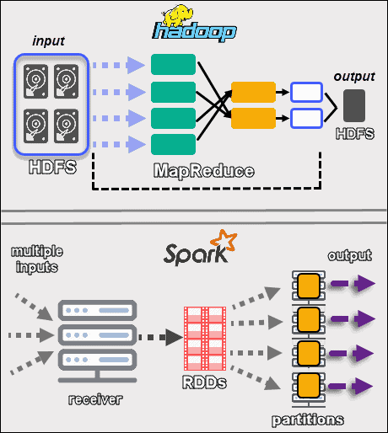
How the Hadoop framework helps Spark's computing efficiency?
integration
operation
performance
community
Hadoop vs Spark: Detailed Comparison of Big Data Frameworks (phoenixnap.com)

Slide 82
Integration
Storage Backbone; Data Locality;Resource management, job scheduling
Operation
Cost, simplified management, data governance, and security
Performance
Serialization, compression
Community
Ecosystem

Slide 83
How YARN Works:
1. Supercomputer Manager:
YARN is like the boss of the supercomputer. It tells the supercomputer what to do and when to do it.
2. Job Organizer of the supercomputers: When people want to use the supercomputer, they tell YARN what they want to do. YARN figures out how much brainpower and memory they need and then finds a good spot for them to work.
3. Checking In: YARN checks in with the people while they're using the supercomputer. It makes sure they're not hogging all the resources and that everything is going smoothly.
4. Keeping Everyone Happy: YARN's main job is to keep everyone happy! It makes sure the supercomputer is being used efficiently so all the people can have fun and learn new things.
So, remember, the next time you want to use a big supercomputer like Hadoop, thank YARN for making it possible! It's like having your own supercomputer manager to make sure everything runs smoothly and everyone gets a turn to play and learn.

Slide 84
Open Colab

Slide 85
Remember
This is crucial for ensuring that all values associated with the same key are sent to the same reducer.
By default, a hash value for each key is computed and assigns the key-value pair to a reducer.
A combiner function is similar to a reducer but operates on the output of the map function before it is shuffled and sent to the reducers.

Slide 86
WHAT DID YOU LEARN ?

Slide 87
Apache Spark
Day 4 & 5

Slide 88
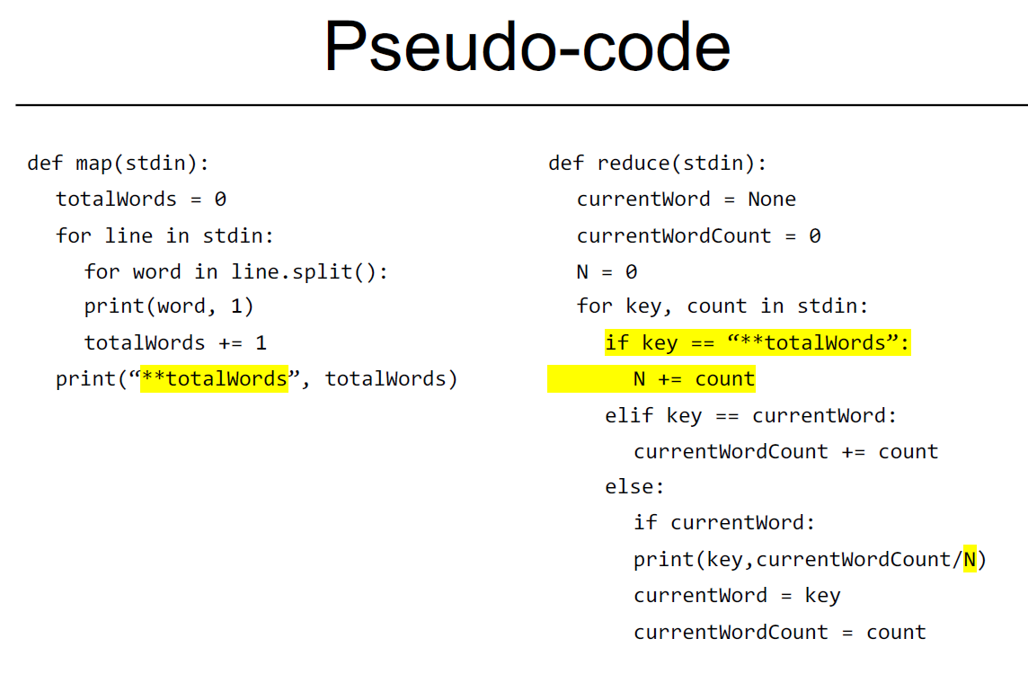
MapReduce Review

Slide 89
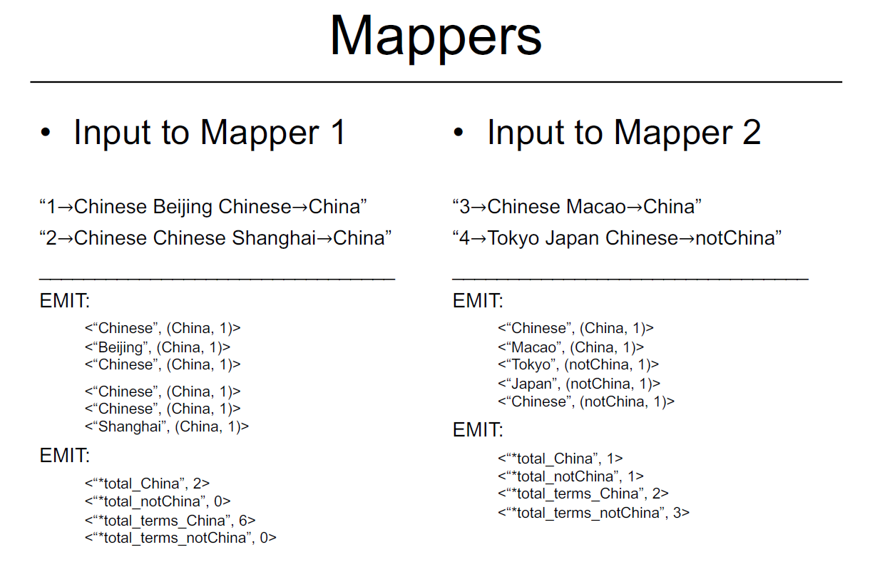

Slide 90
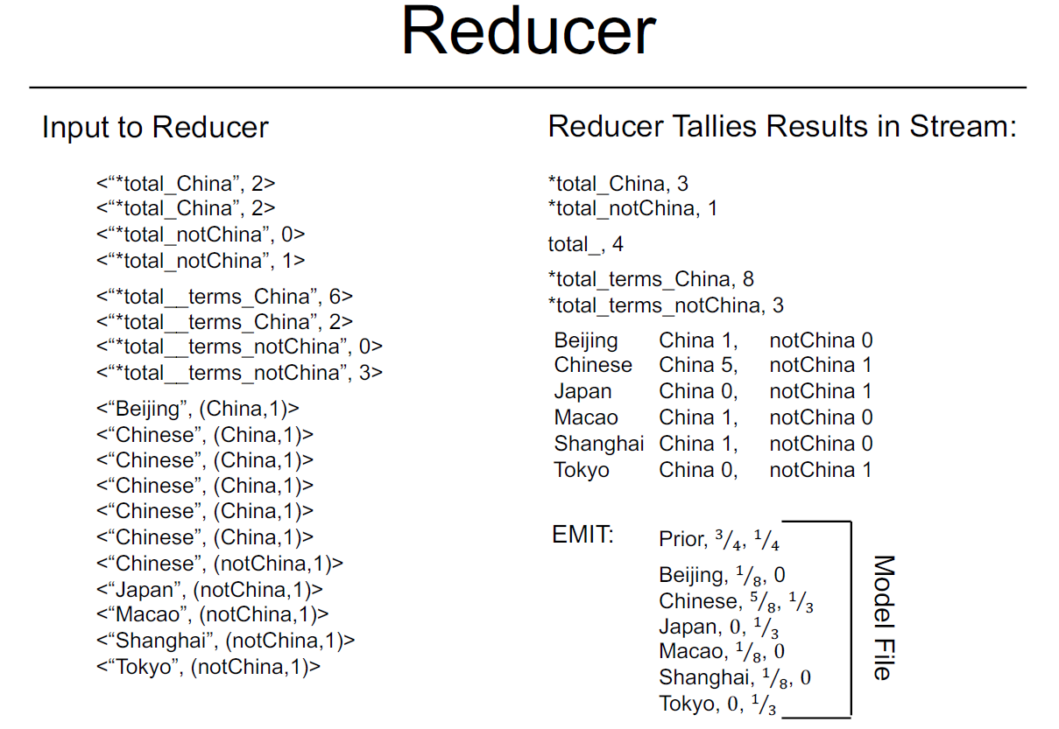

Slide 91
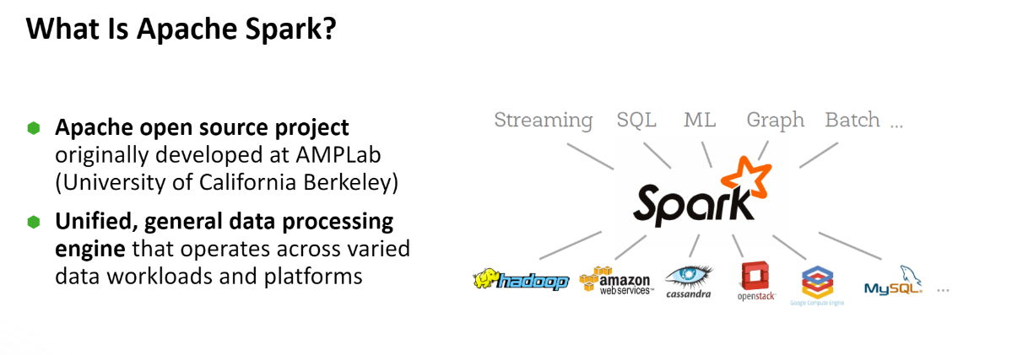

Slide 92
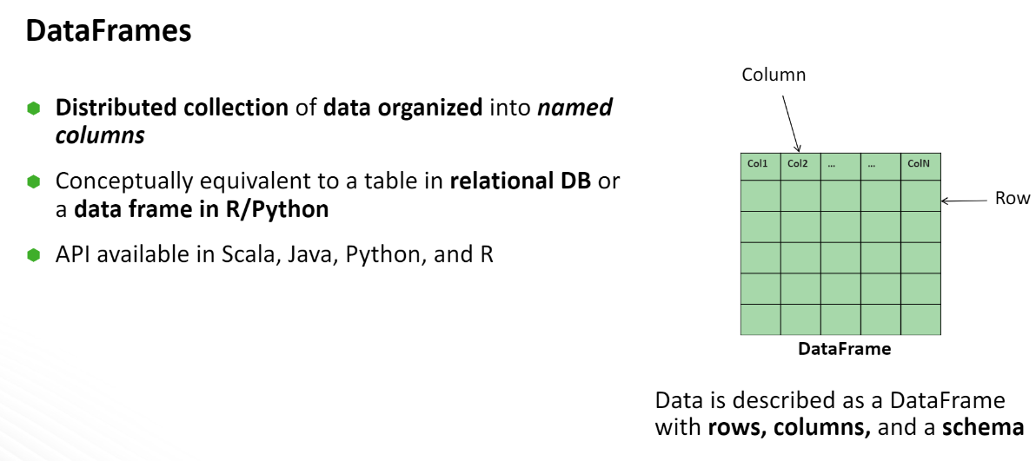

Slide 93
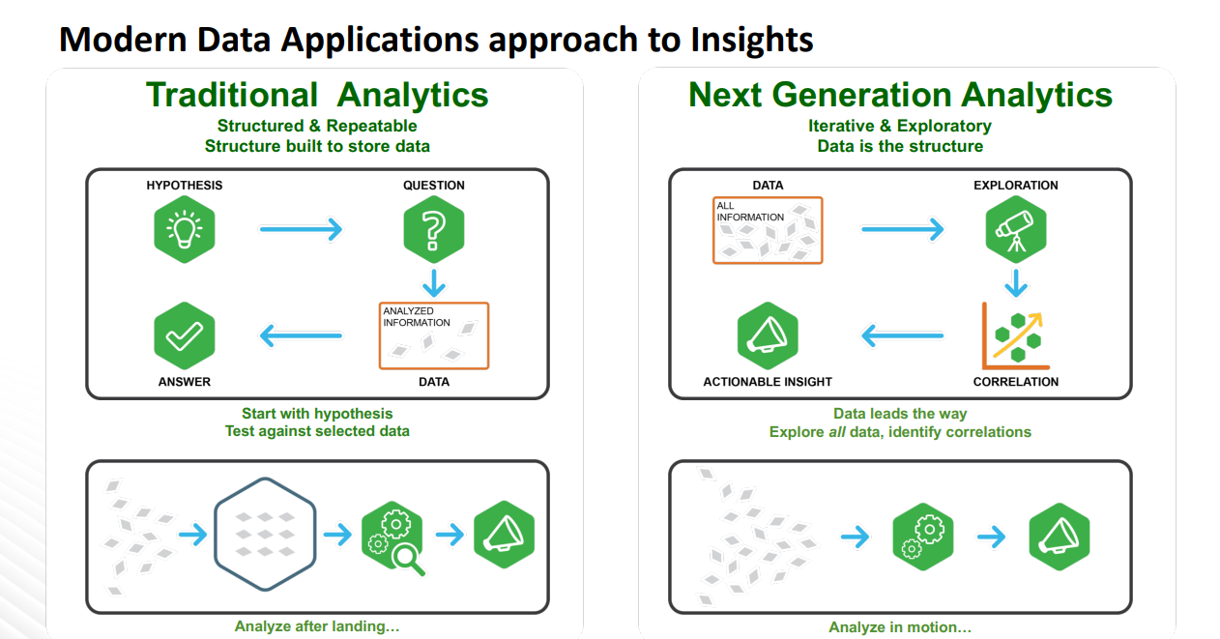

Slide 94
